Slide 1
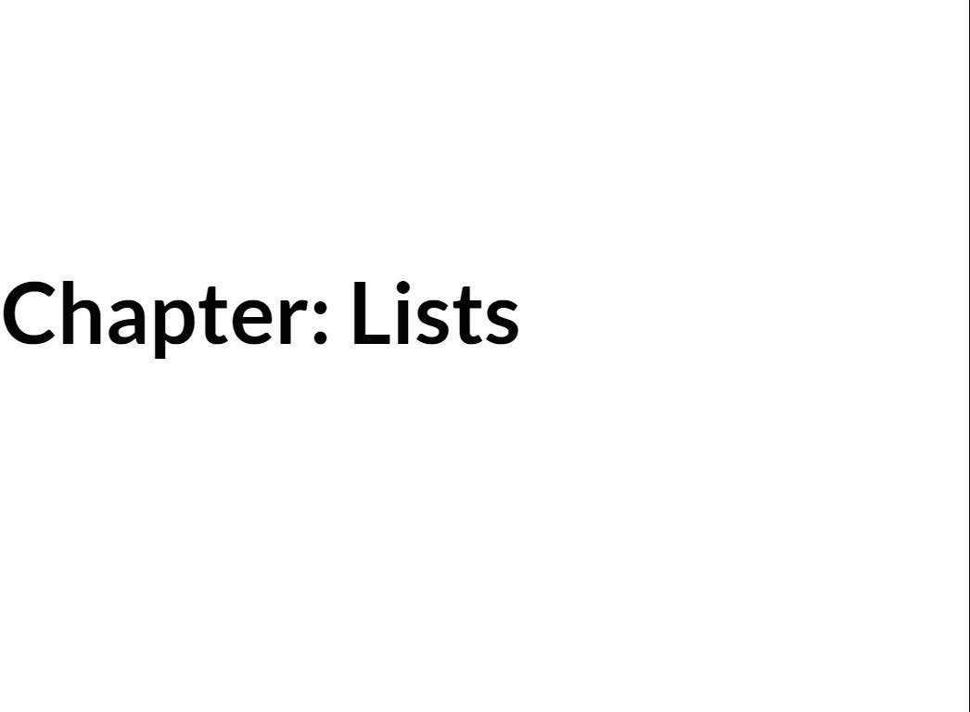

Slide 2
What You Will Learn
Lists
Searching in Lists
Exception Handling
Slices
Ranges
For Loop
While Loop

Slide 3


Slide 4
Lists
A list is a data type that holds an ordered collection of items.
The items can be of various data types.
You can even have lists of lists!

Slide 5
Creating Lists
list_name = [item_1, item_2, item_N] list_name = []
list_name[index]

Slide 6

animals= ['man', 'bear', 'pig'] print(animals[O]) print(animals[l]) print(animals[2])
man bear

Slide 7
animals= ['man', 'bear', 'pig'] print(animals[O])
animals[O] = 'cat'
print(animals[O])
man cat

Slide 8
animals= ['man', 'bear', 'pig'] print(animals[-1]) print(animals[-2]) print(animals[-3])
pi^{I} g bear man

Slide 9
animals= ['man', 'bear', 'pig'] animals.append('cow') print(animals[-1])
cow

Slide 10
animals = ['man', 'bear', 'pig']
animals.extend(['cow', 'duck'])
print(animals)
more animals = ['horse', 'dog'] animals.extend(more animals) print(animals)
['man', | 'bear', | 'pig', | 'cow', | 'duck']
['man', | 'bear', | 'pig', | 'cow', | 'duck', | 'horse', | 'dog']

Slide 11
a ni ma l s = [ ' ma n ' ,
' b e ar ' ,
' h or s e ' )
' p i g ' ]
a n i ma l s . i n s er t ( O , pr i n t ( a n i ma l s )
a n i ma l s . i n s er t ( 2 , pr i n t ( a n i ma l s )
' d u c k ' )
[ ' h or s e ' ,
[ ' h or s e ' ,
' ma n ' ,
' ma n ' ,
' b e ar ' ,
' d u c k ' ,
' p i g ' ]
' b e ar ' ,
' p i g ' ]

Slide 12
i•ces

Slide 13
Slices
list[indexl:index2] list [:index2]
list [ indexl:]

Slide 14
anmials
['man', 'bear', 'pig', 'cow', 'duck', 'horse']
some animals = animals[l:4]
print('Some animals: {}'.format(some animals))
first two = animals[0:2]
print('First two animals: {}'.format(first two))
first two again = animals[:2]
print('First two animals: {}'.format(first two again))

Slide 15
Some animals: ['bear', 'pig', 'cow']
First two animals: First two animals:
['man', 'bear']
['man', 'bear']

Slide 16
animals = ['man', 'bear', 'pig', 'cow', 'duck', 'horse']
last two = animals[4:6] print('Last two animals:
{}'.format(last two))
last two again = animals[-2:] print('Last two animals:
{}'.format(last two again))

Slide 17
two animals: two animals:
Last Last
[ ' d u c k ' ,
[ ' d u c k ' ,
'horse']
'horse']

Slide 18
String Slices
part_of_a_horse = 'horse'[1:3] print(part_of_a_horse)
or

Slide 19
Finding an item in a list.
animals= ['man', 'bear', 'pig'] bear_index = animals.index('bear') print(bear_index)
1

Slide 20
Exceptions
animals = ['man', 'bear', 'pig'] cat index = animals.index('cat') print(cat index)
Traceback (most recent call last):
File ''exception example.py'', line 2, in <module>
cat index = animals.index('cat')
ValueError: 'cat' is not in list

Slide 21
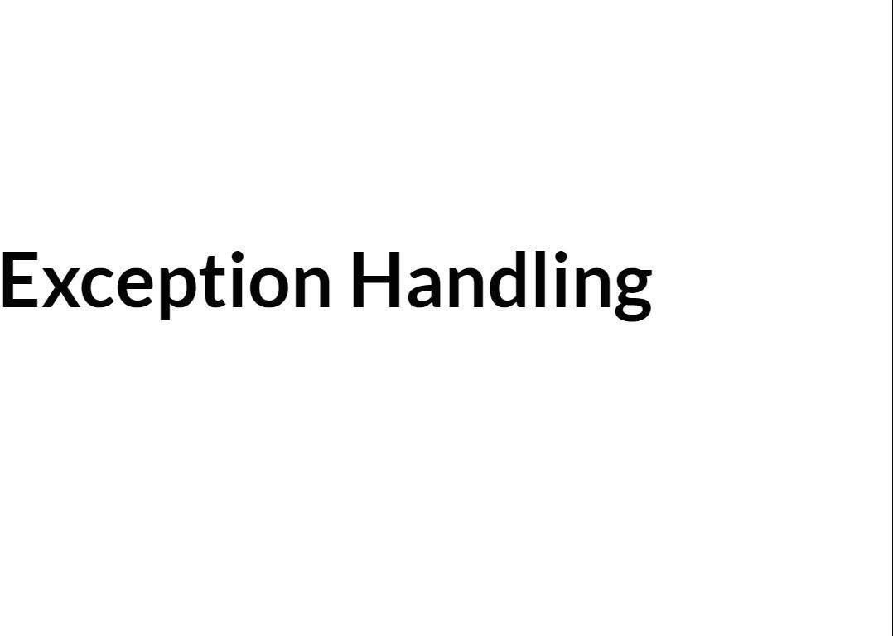

Slide 22
Exception Handling
animals= ['man', 'bear', 'pig'] try:
cat index= animals.index('cat') except:
cat index print(cat index)
'No cats found.'
No cats found.

Slide 23
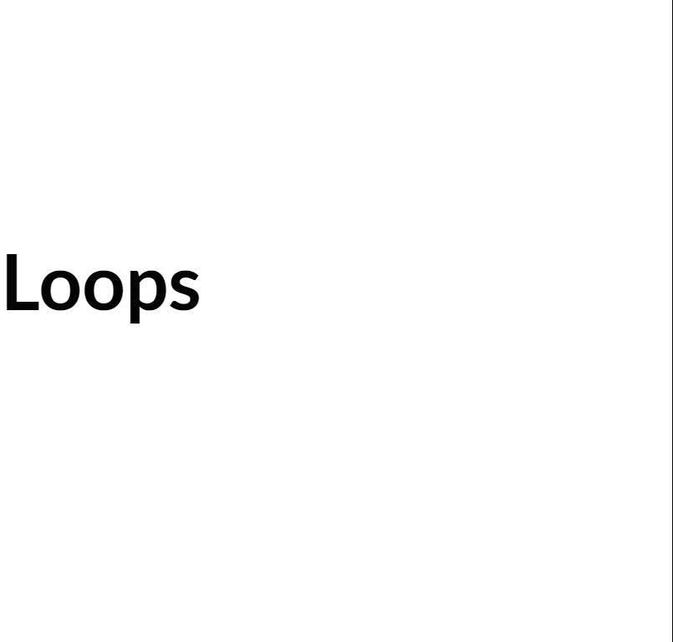

Slide 24
Looping through a list
for item_variable in list_name: # Code block
item_variable item_variable
= list[O]
= list[l]
item variable= list[N]

Slide 25
animals= ['man', 'bear', 'pig'] for animal in animals:
print(animal.upper())
MAN BEAR PIG

Slide 26
While Loop
while condition:
# Code block

Slide 27

['man', 'bear', 'pig', 'cow', 'duck', 'horse']
animals
index 0
while index < len(animals): print(animals[index]) index += 1
man bear
cow duck horse

Slide 28
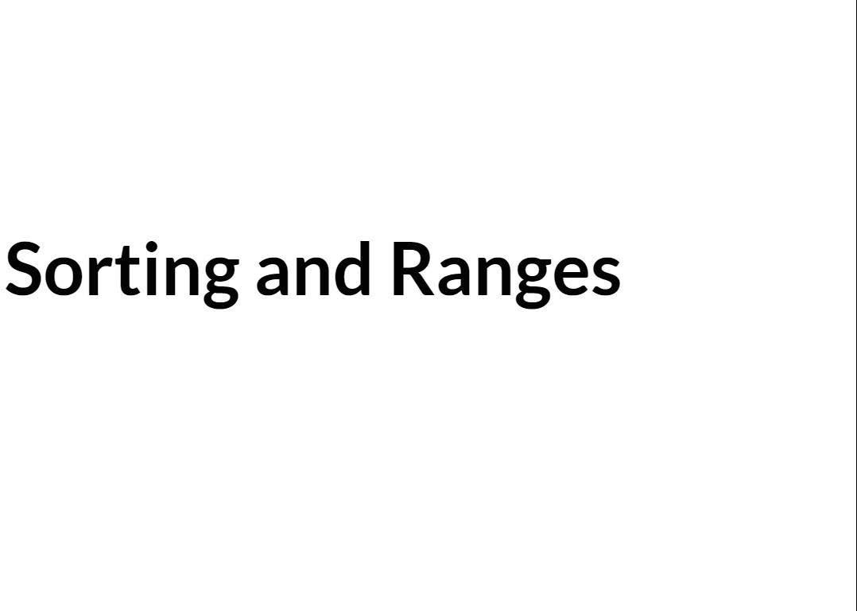

Slide 29
animals = ['man', 'bear', 'pig'] sorted animals = sorted(animals)
print('Animals list: print('Sorted animals list:
animals.sort()
{}'.format(animals))
{}'.format(sorted animals))
print('Animals after sort method: {}'.format(animals))
Animals list: Sorted animals list:
['man', 'bear', 'pig']
['bear', 'man', 'pig']
Animals after sort method: ['bear', 'man', 'pig']

Slide 30
animals= ['man', 'bear', 'pig']
more animals= ['cow', 'duck', 'horse'] all animals= animals+ more animals print(all animals)
[ 'man' ,
'bear' ,
'pig' ,
'cow' ,
'duck' ,
'horse' ]

Slide 31
animals= ['man', 'bear', print(len(animals)) animals.append('cow') print(len(animals))
'pig']
3
4

Slide 32
Ranges
for number in range(3): print(number)
0
1
2

Slide 33
for number in range(l, 3): print(number)
1
2

Slide 34
for number in range(l, 10, 2): print(number)
1
3
5
7
9

Slide 35
for number in range(O, len(animals), 2): print(animals[number])
animals | = [ 'man', | 'bear', | 'pig', | 'cow',
'duck', | 'horse', | 'dog']
man pi^{I} g duck dog

Slide 36


Slide 37
Summary
Lists are created using comma separated values between square brackets. The format 1• s:
list name = [item 1, item 2, item N]

Slide 38
Summary
Items in a list can be accessed by index. List indices are zero based. The format is: list_name[index]
Access items from the end of the list by using negative indices. The last item in a list is: list name[-1]

Slide 39
Summary
Add items to a list by using the append () or
extend () list methods.
Access a portion of a list using a slice. The format is: list_name (start,
stop)
The list index () method accepts a value as a parameter and returns the index of the
first value in the list or an exception if the

Slide 40
Summary
Loop through a list using a for loop. The
format is for | i tem_variable | in
list_name: | followed by a code
block.
The code block in a while loop executes as long as the condition evaluates to true. The format is while condition: followed by
< ► > Sl i d e 40 T
151 ,, m T •
Notes Pointe,
Q & A
Captions
Tips
0 EXIT

Slide 41
Summary
To sort a list, use the sort () list method or the built-in sorted () function.
The built-in range () function generates
a list of numbers. The format is: range (start, stop, step)
Unhandled exceptions cause Python programs to terminate. Handle exceptions
using try/ except blocks.

